Slide 1

BlinkIT Grocery Data Report
Jedidiah Solomon
12/08/2024

Slide 2
Introduction

Slide 3
Blinkit is India's largest and most convenient hyper-local delivery company, which enables you to order groceries, fruits & vegetables, and other daily essential products, directly via your mobile or web browser.
The purpose of this project is to analyze grocery sales data to identify trends, understand customer preferences, and provide actionable insights for optimizing sales performance across different outlet types and product categories.
The dataset contains detailed sales records from various grocery outlets, covering multiple years. It includes information on product categories, fat content, outlet types, outlet sizes, and the year of establishment.

Slide 4
Key Variables Analyzed:
Total Sales: Overall sales figure
Item Fat Content: Sales distribution between low-fat and regular items, showing customer preferences
Item Types: Performance of different product categories (e.g., Fruits, Snacks, Dairy, etc.), identifying top-performing and underperforming categories.
Outlet Types: Analysis of sales across different outlet formats (Supermarkets, Grocery Stores) to determine which types generate the most revenue.
Outlet Size: Impact of outlet size (Small, Medium, Large) on total sales, providing insights into optimal store formats
Year of Establishment: Sales trends based on the year outlets were established, helping to understand the correlation between outlet age and sales performance.

Slide 5
Visualizations

Slide 6
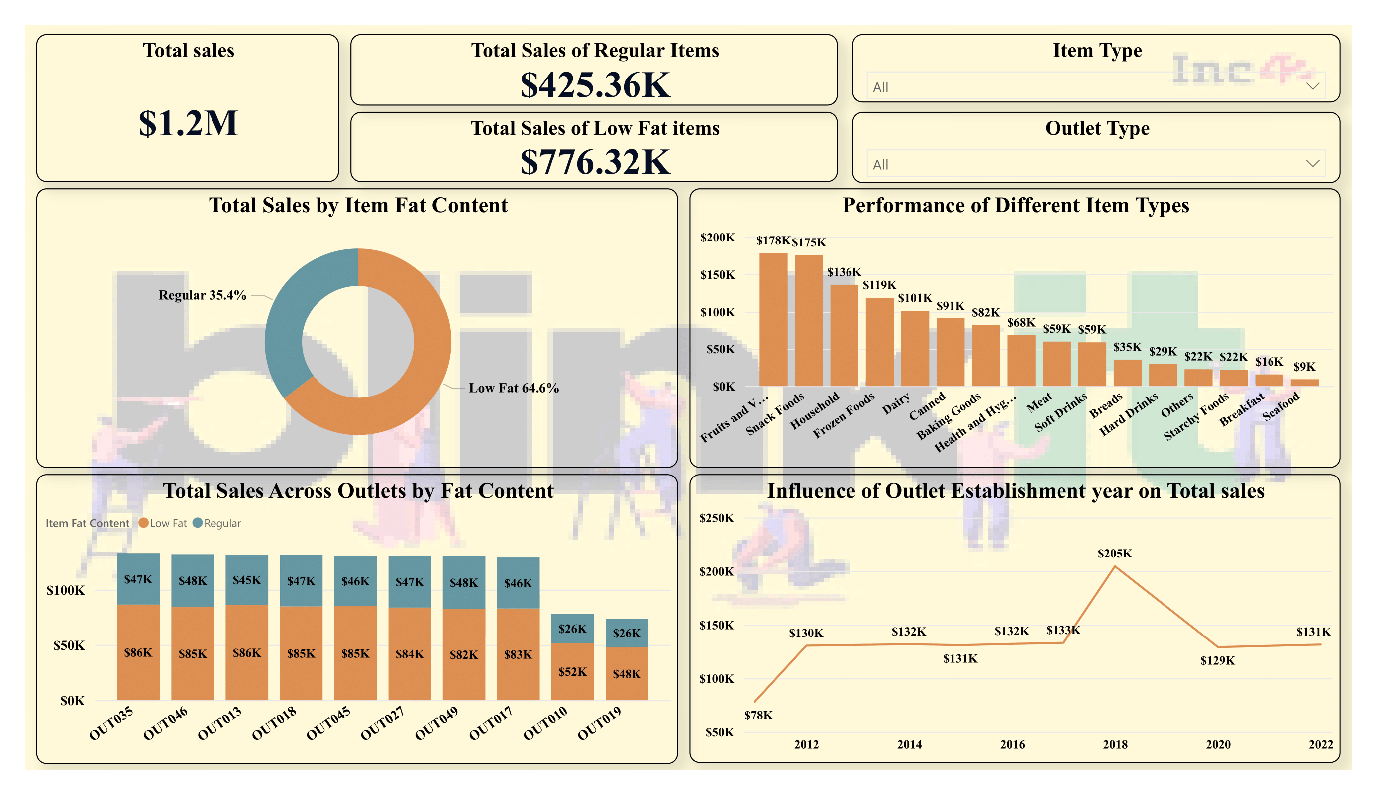

Slide 7
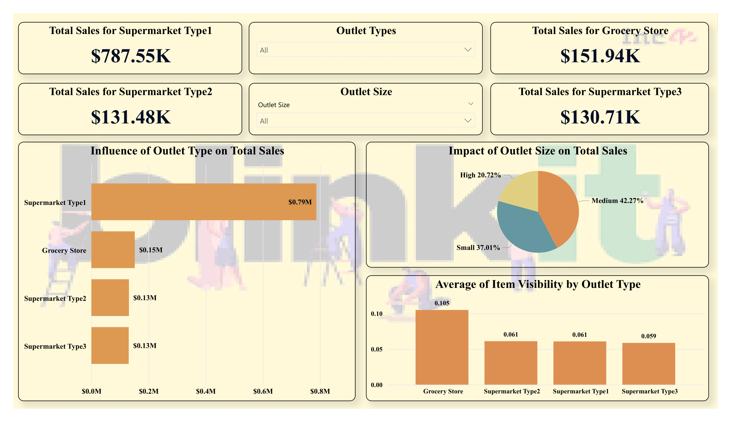

Slide 8
Insights

Slide 9
Sales by Fat Content:
Low-fat items account for 64.6% of total sales, while regular items account for 35.4%. This indicates a preference for low-fat products among customers.
Top-Performing Item Types:
The highest-performing item types are Fruits and Vegetables, Snack Foods, and Household Items, each generating over $100K in sales.
Seafood and Breakfast items are the lowest-performing categories, contributing the least to total sales.
Sales Distribution Across Outlets:
Sales distribution across different outlets is relatively consistent, with most outlets generating between $120K to $130K in total sales, except for a few outliers like OUT017 and OUT010 with slightly lower sales.
Outlet Types:
Supermarket Type 1 is the most successful outlet type, generating $787.55K in sales.
Grocery Stores and Supermarket Types 2 & 3 have significantly lower sales, around $130K to $150K.

Slide 10
Influence of Outlet Establishment Year:
Outlets established in 2018 saw a peak in total sales ($205K), indicating a potential correlation between newer establishments and higher sales.
Impact of Outlet Size:
Medium-sized outlets contribute the most to total sales (42.27%), followed by small-sized outlets (37.01%). High-sized outlets have the least impact (20.72%).
Average Item Visibility:
Grocery stores have the highest average item visibility, which could explain their relatively better performance among smaller outlets.
Supermarket Type 1 and Type 2 have lower item visibility but still manage to generate higher sales, suggesting a loyal customer base or higher foot traffic.

Slide 11
Predictions

Slide 12
Growth in Low-Fat Product Sales:
As health trends continue to influence consumer behavior, sales of low-fat items are likely to grow further. Consider stocking up on low-fat alternatives across more product categories.
Potential Decline in Older Outlets:
Outlets that have been around for longer may see a decline in sales if not regularly upgraded or refreshed. It may be beneficial to invest in renovations or marketing efforts for older outlets.
Continued Success of Medium-Sized Outlets:
Medium-sized outlets will likely continue to dominate sales if current trends hold. Expanding the medium-sized format could be a key growth strategy moving forward.

Slide 13
Recommendations

Slide 14
Focus on Low-Fat Products:
Given the high sales of low-fat items, consider expanding the range of low-fat products or promoting them more heavily across outlets.
Boost Underperforming Categories:
Consider targeted promotions or bundling offers for categories like Seafood and Breakfast items to boost their sales.
Leverage Successful Outlet Types:
Invest more in expanding or upgrading Supermarket Type 1 outlets since they generate the most sales. Consider converting lower-performing outlets into Type 1 supermarkets where feasible.

Slide 15
Optimize Outlet Size Strategy:
Focus on optimizing medium-sized outlets, as they generate the most sales. Analyze if there is potential to upscale small outlets to medium size to boost overall sales.
Enhance Item Visibility:
Improve item visibility in Supermarket Types 2 and 3 to match or exceed that of grocery stores, potentially increasing sales in these outlets.

Slide 16
Conclusion

Slide 17
The analysis of the grocery sales data reveals clear trends and actionable insights that can guide future strategies. Customers show a strong preference for low-fat products, and certain categories like Fruits, Vegetables, and Snacks are top performers. Supermarket Type 1 outlets and medium-sized stores contribute the most to overall sales, suggesting a successful format that could be replicated or expanded.
To capitalize on these insights, it is recommended to focus on enhancing the visibility and availability of low-fat items, invest in top-performing outlet types, and consider strategies to boost sales in underperforming categories.
By aligning strategies with these findings, the grocery chain can optimize its operations, drive higher sales, and better meet customer needs.

Slide 18
Thanks for Listening

